Slide 1
Disaggregation of Household Appliances
David Croghan, Nima Latifi, Rosa Donat, David Jones, Mark Richard

Slide 2
Overview
Introduction
Problem statement
Previous work
Model architectures and results
Factorial Hidden Markov Model
Neural Networks
Anomaly Detection
Summary
Visualizations
Conceptual Design for scalable solution

Slide 3
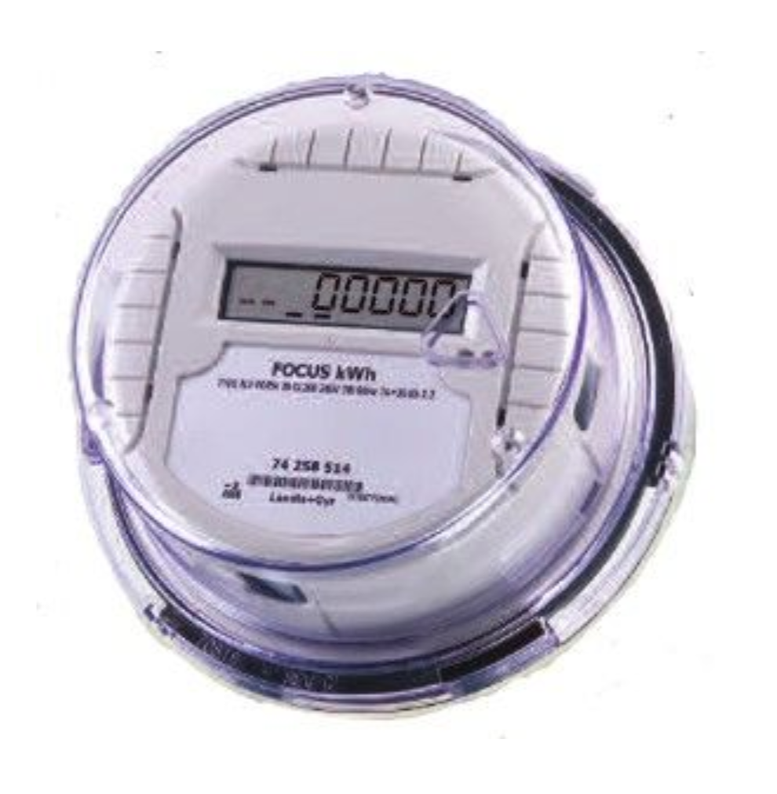
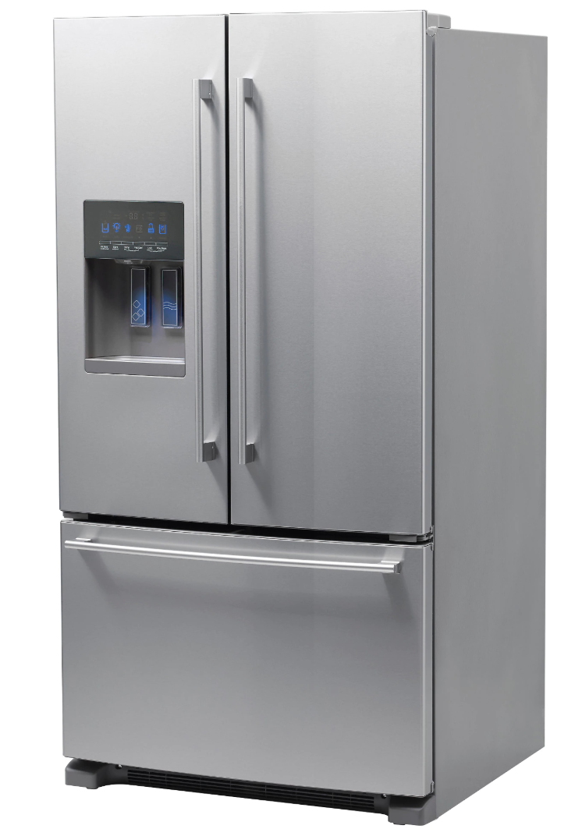
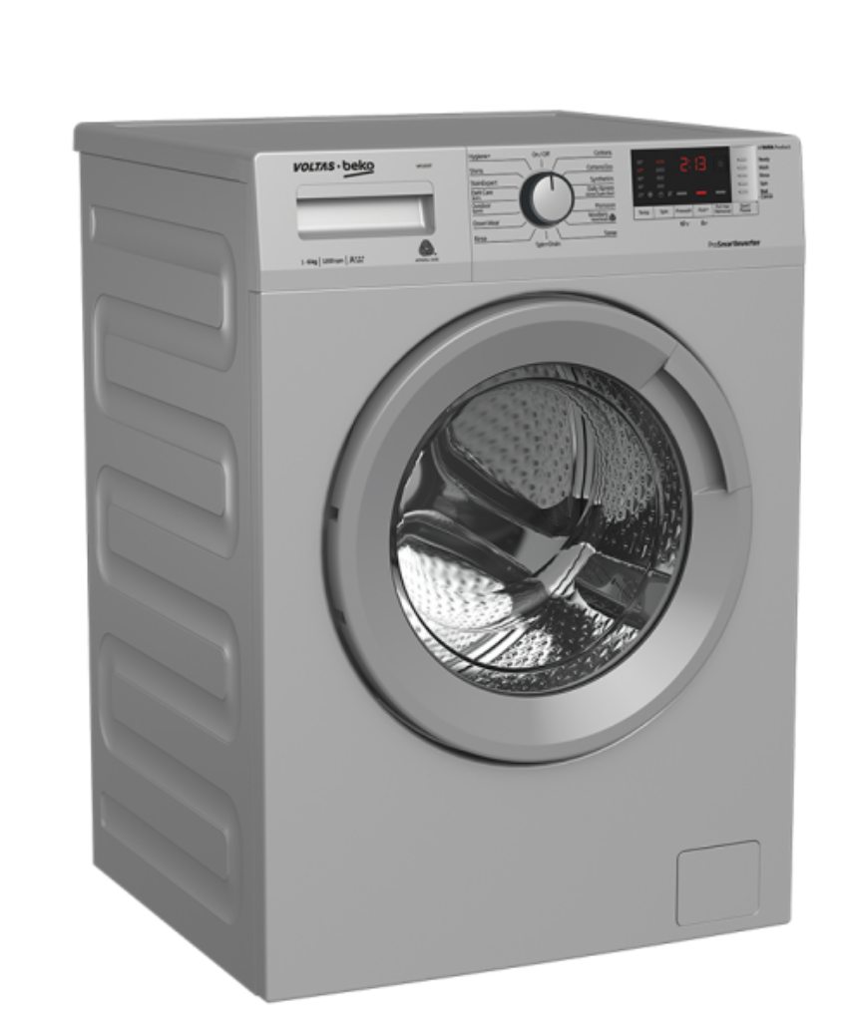
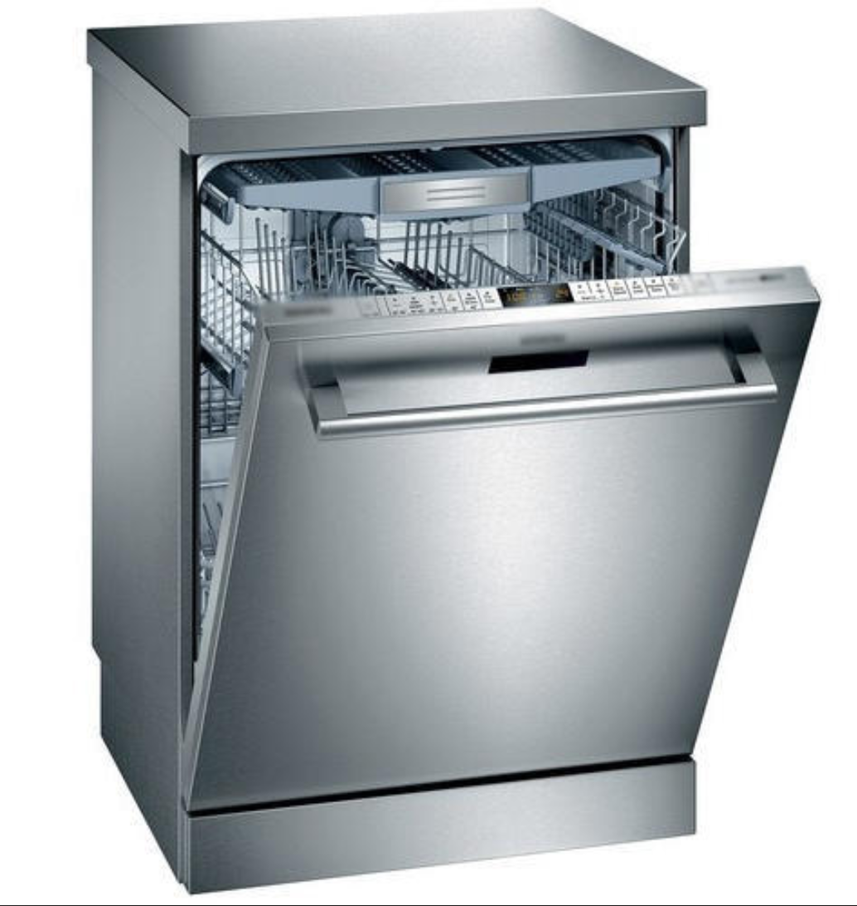
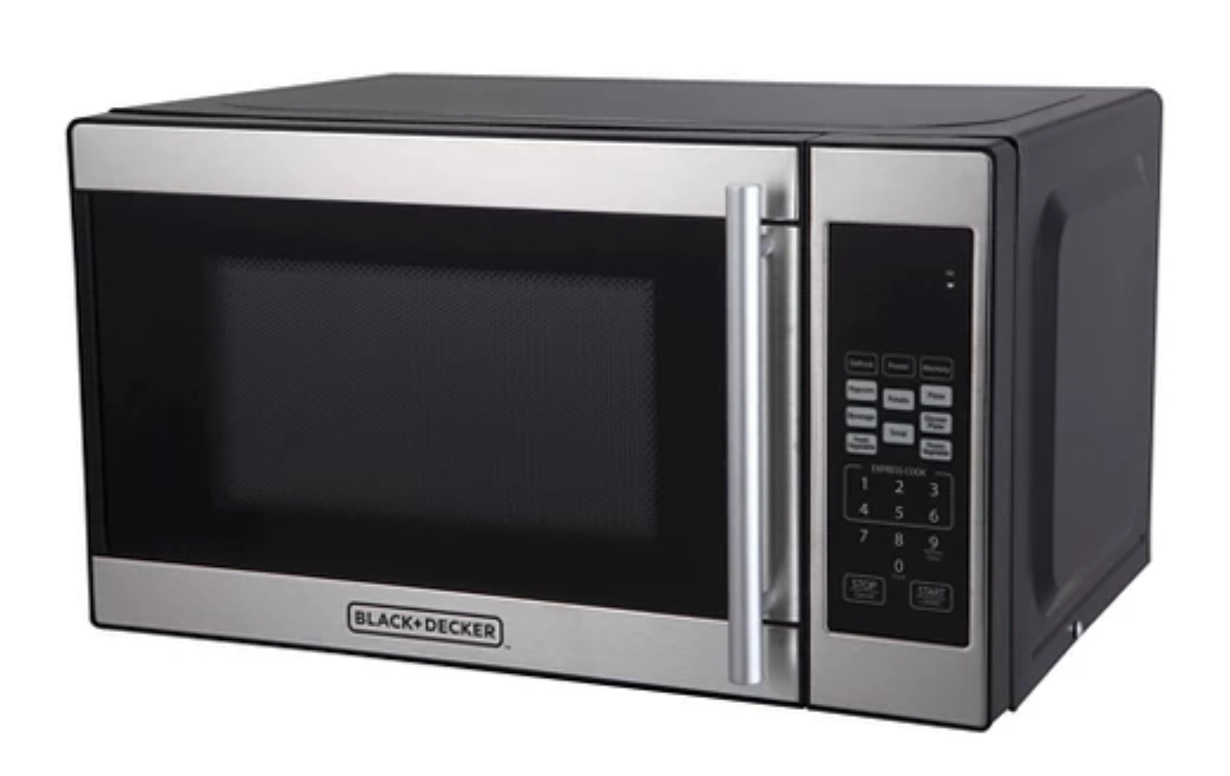
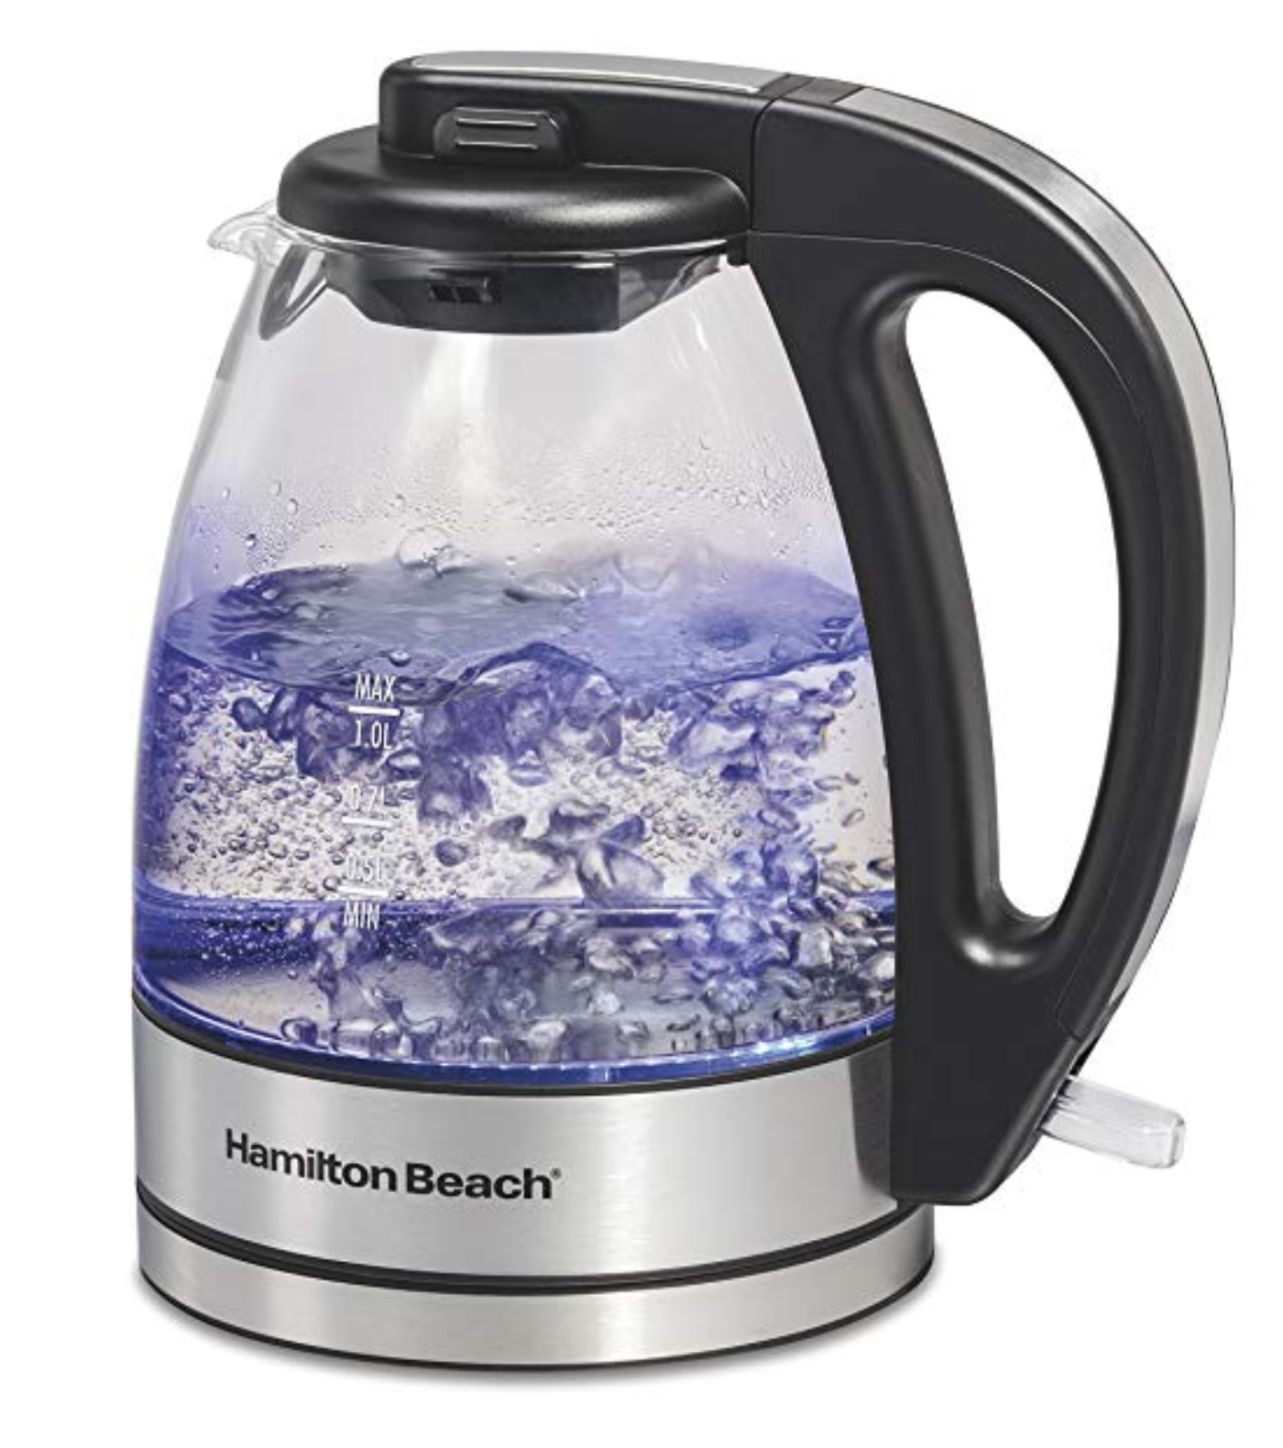
Disaggregate [ dis-ag-ri-geyt ]
verb to separate (an aggregate or mass) into its component parts.
Notes:
What is a smart meter? Give good explanation of what aggregate means
Why can’t you measure each appliance individually? Expensive. Would take a long time. People move in and out constantly.
Energy disaggregation - process of estimating the energy consumed by individual appliances given just the whole house power reading

Slide 4
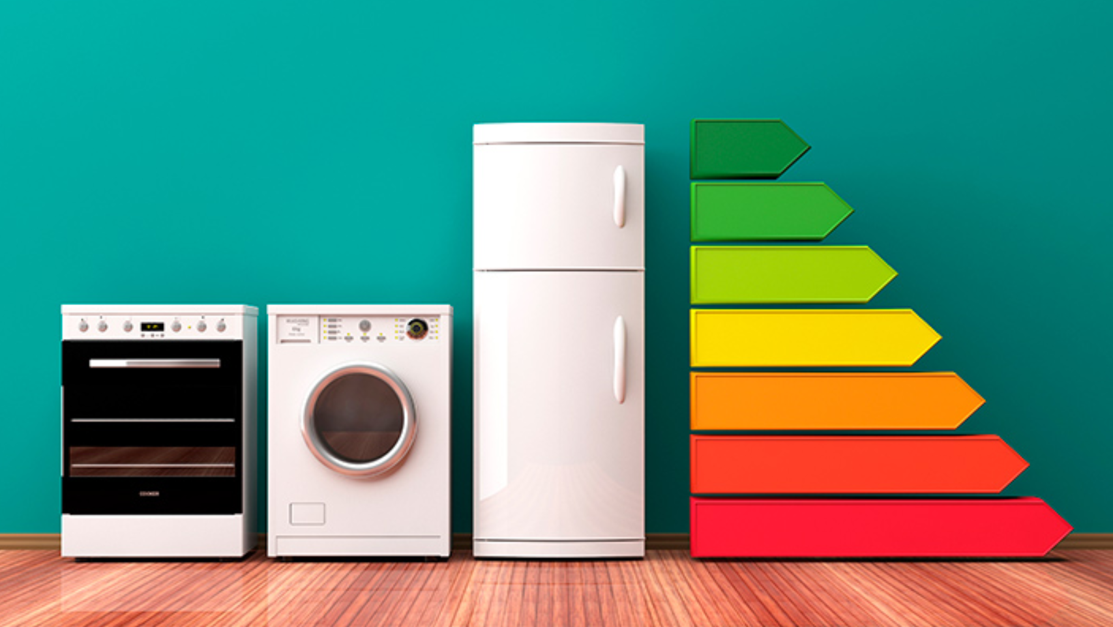
Energy Efficiency and Data Science
Utilities have tons of smart meter data available, but only use it for billing
Can we use smart meter data more intelligently?
Can we use disaggregation algorithms to help residential customers use energy more efficiently?
Notes:
Utilities have been collecting residential smart meter data for years, but only use it to create your electric bill. How can we use data science to address this problem?

Slide 5
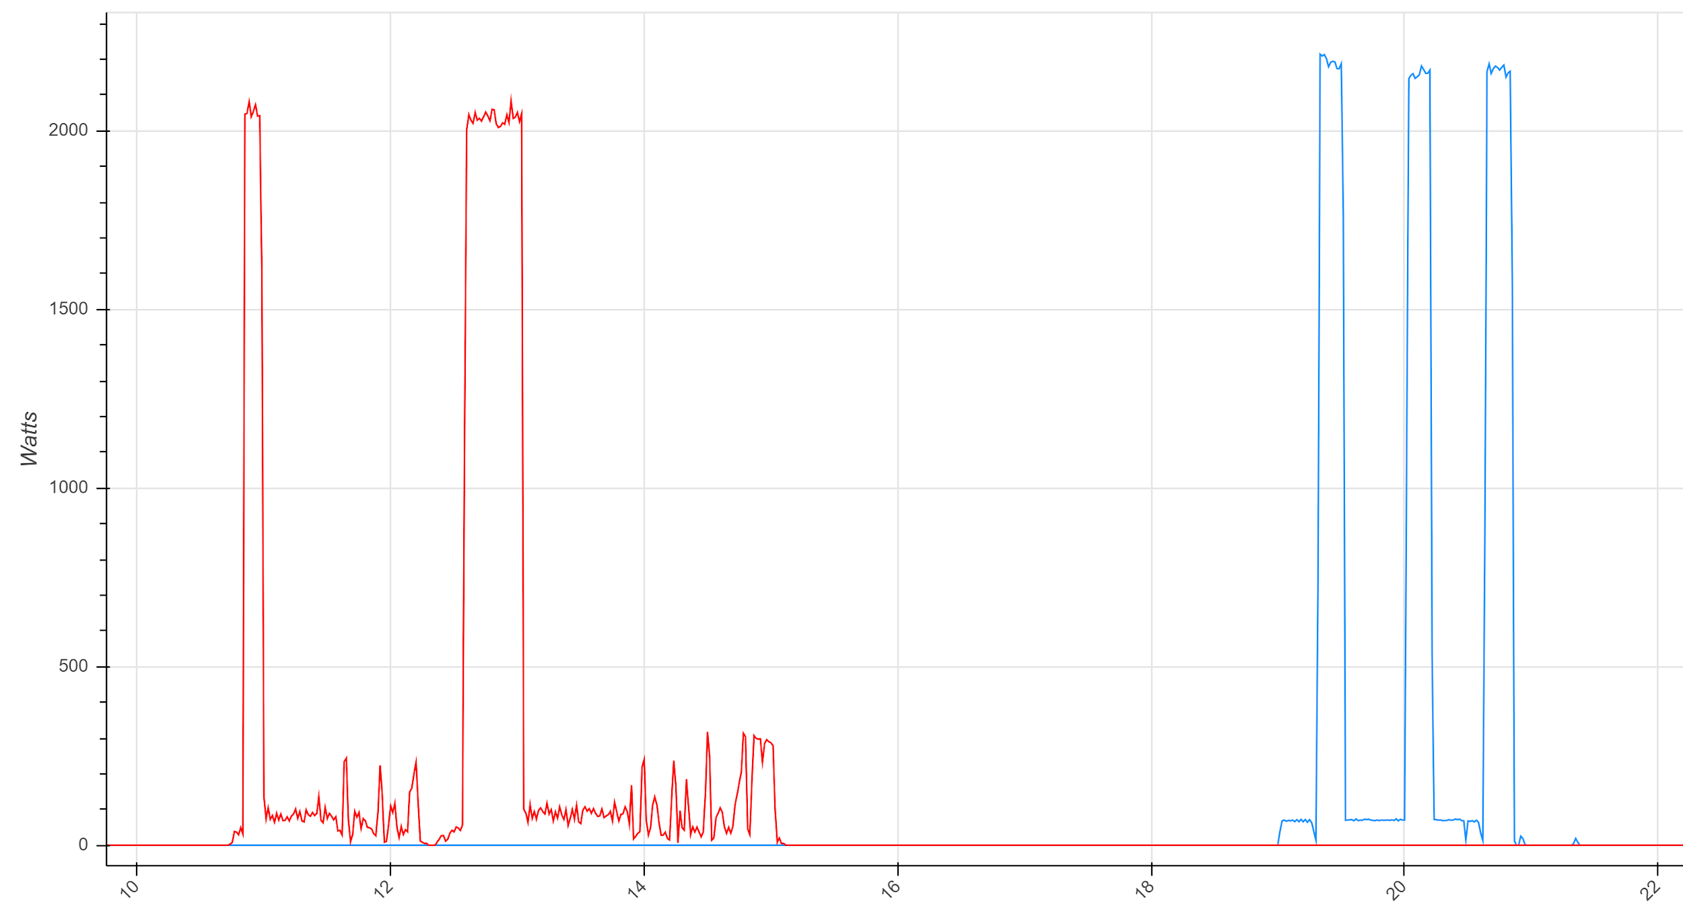
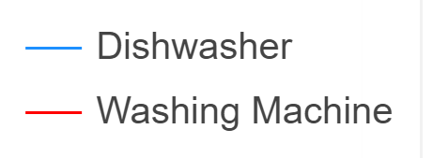
Energy Disaggregation
Name the appliance
Time (Hr)
Notes:
Appliance energy consumption can have distinct patterns and waveform that can be used to determine when they are turned on and off. If we understood typical appliance usage patterns and waveforms, we could infer the appliance load using only the aggregate smart meter data. What appliance do you think this is? (trick question, there are actually two)
Ask audience to name the appliance using appliance data and then using aggregate

Slide 6
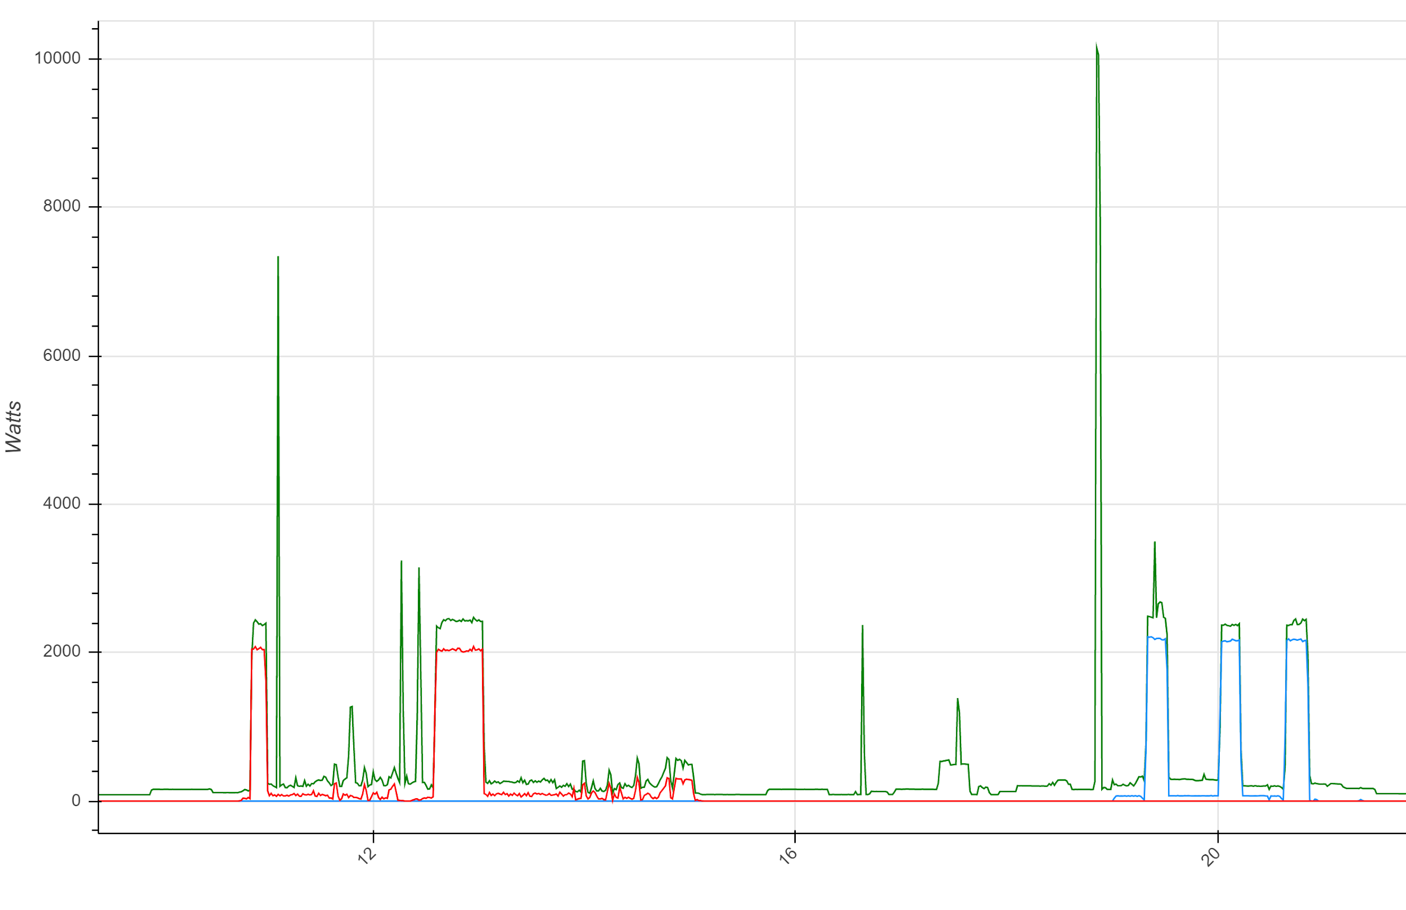
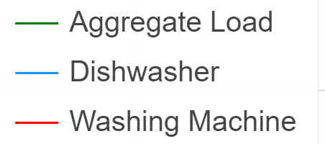
Energy Disaggregation
Time (Hr)

Slide 7
Energy Disaggregation Applications
Electric Utilities
Refine customer rebate and incentive programs
Identify appliances for demand response programs
Understand customer behavior to improve capacity planning
Customers
Plan your monthly budget
Save money with time-of-use electricity rates
Identify and replace inefficient appliances
Notes:
One of the use cases for energy disaggregation algorithms is to create an itemized energy bill showing how much energy usage can be attributed to each major appliance.

Slide 8
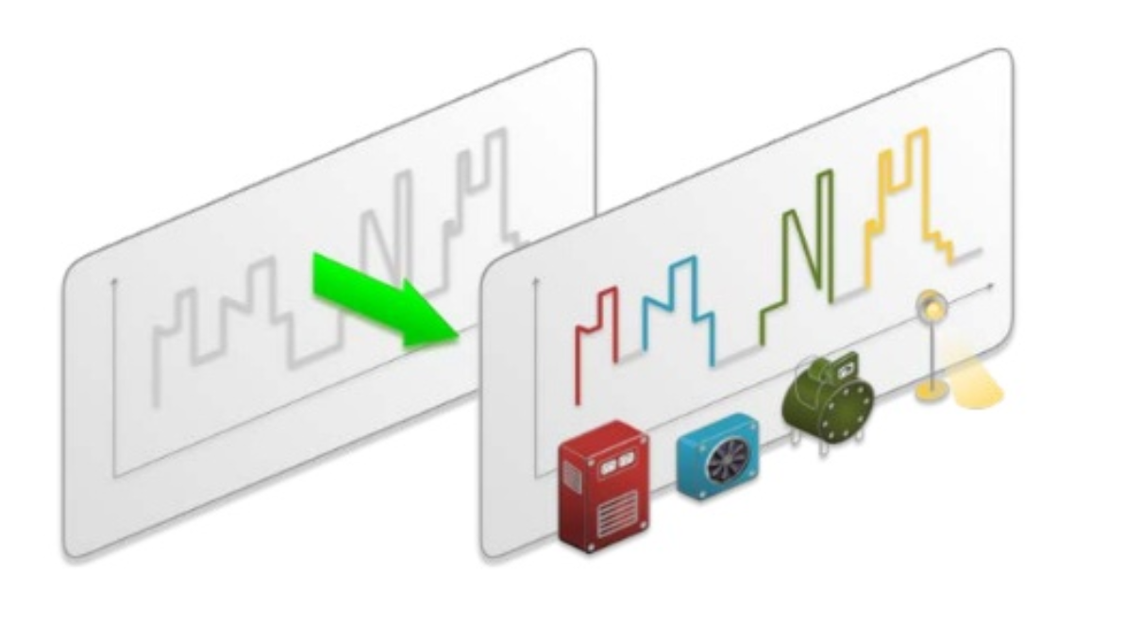
Disaggregation Challenges
Lack of public labeled datasets
Wide variety of appliance types
Limitations in smart meter data sampling rate (only read every 15-30 min)
Notes:
Until recently open source datasets only included a handful of houses. To develop accurate models, need a lot more training data
Signatures of a particular appliance type can vary. Some appliances have different operating modes
Electric utilities only measure smart meter data every 15-30 min. This sampling rate is too low to accurately identify appliance load signatures

Slide 9
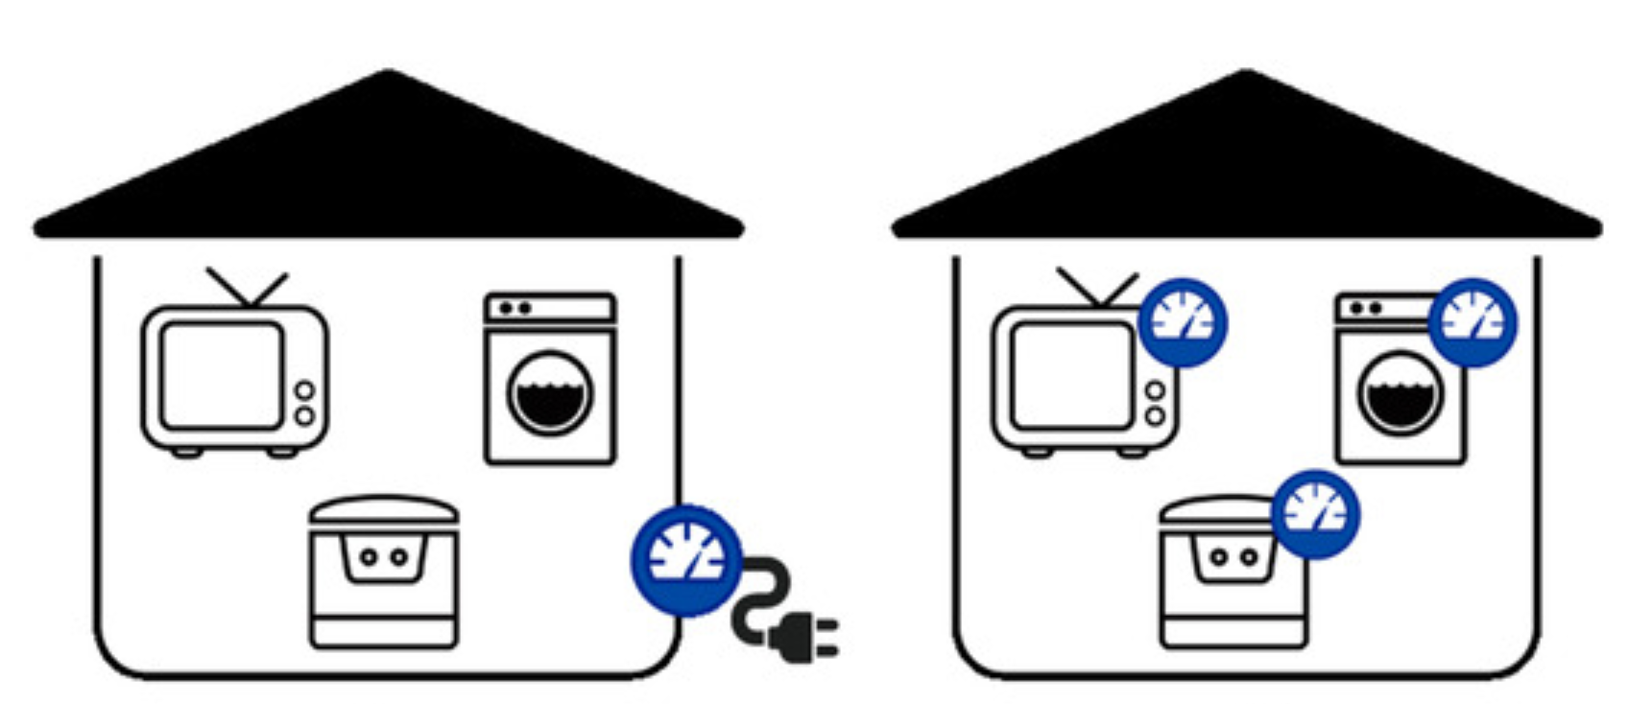

REFIT Dataset
Smart meter and sub-metered appliance measurements at 8 second intervals
20 houses
~ 2 years of data between 2013 and 2015
9 appliances per house
Largest open-source energy disaggregation data set

Slide 10
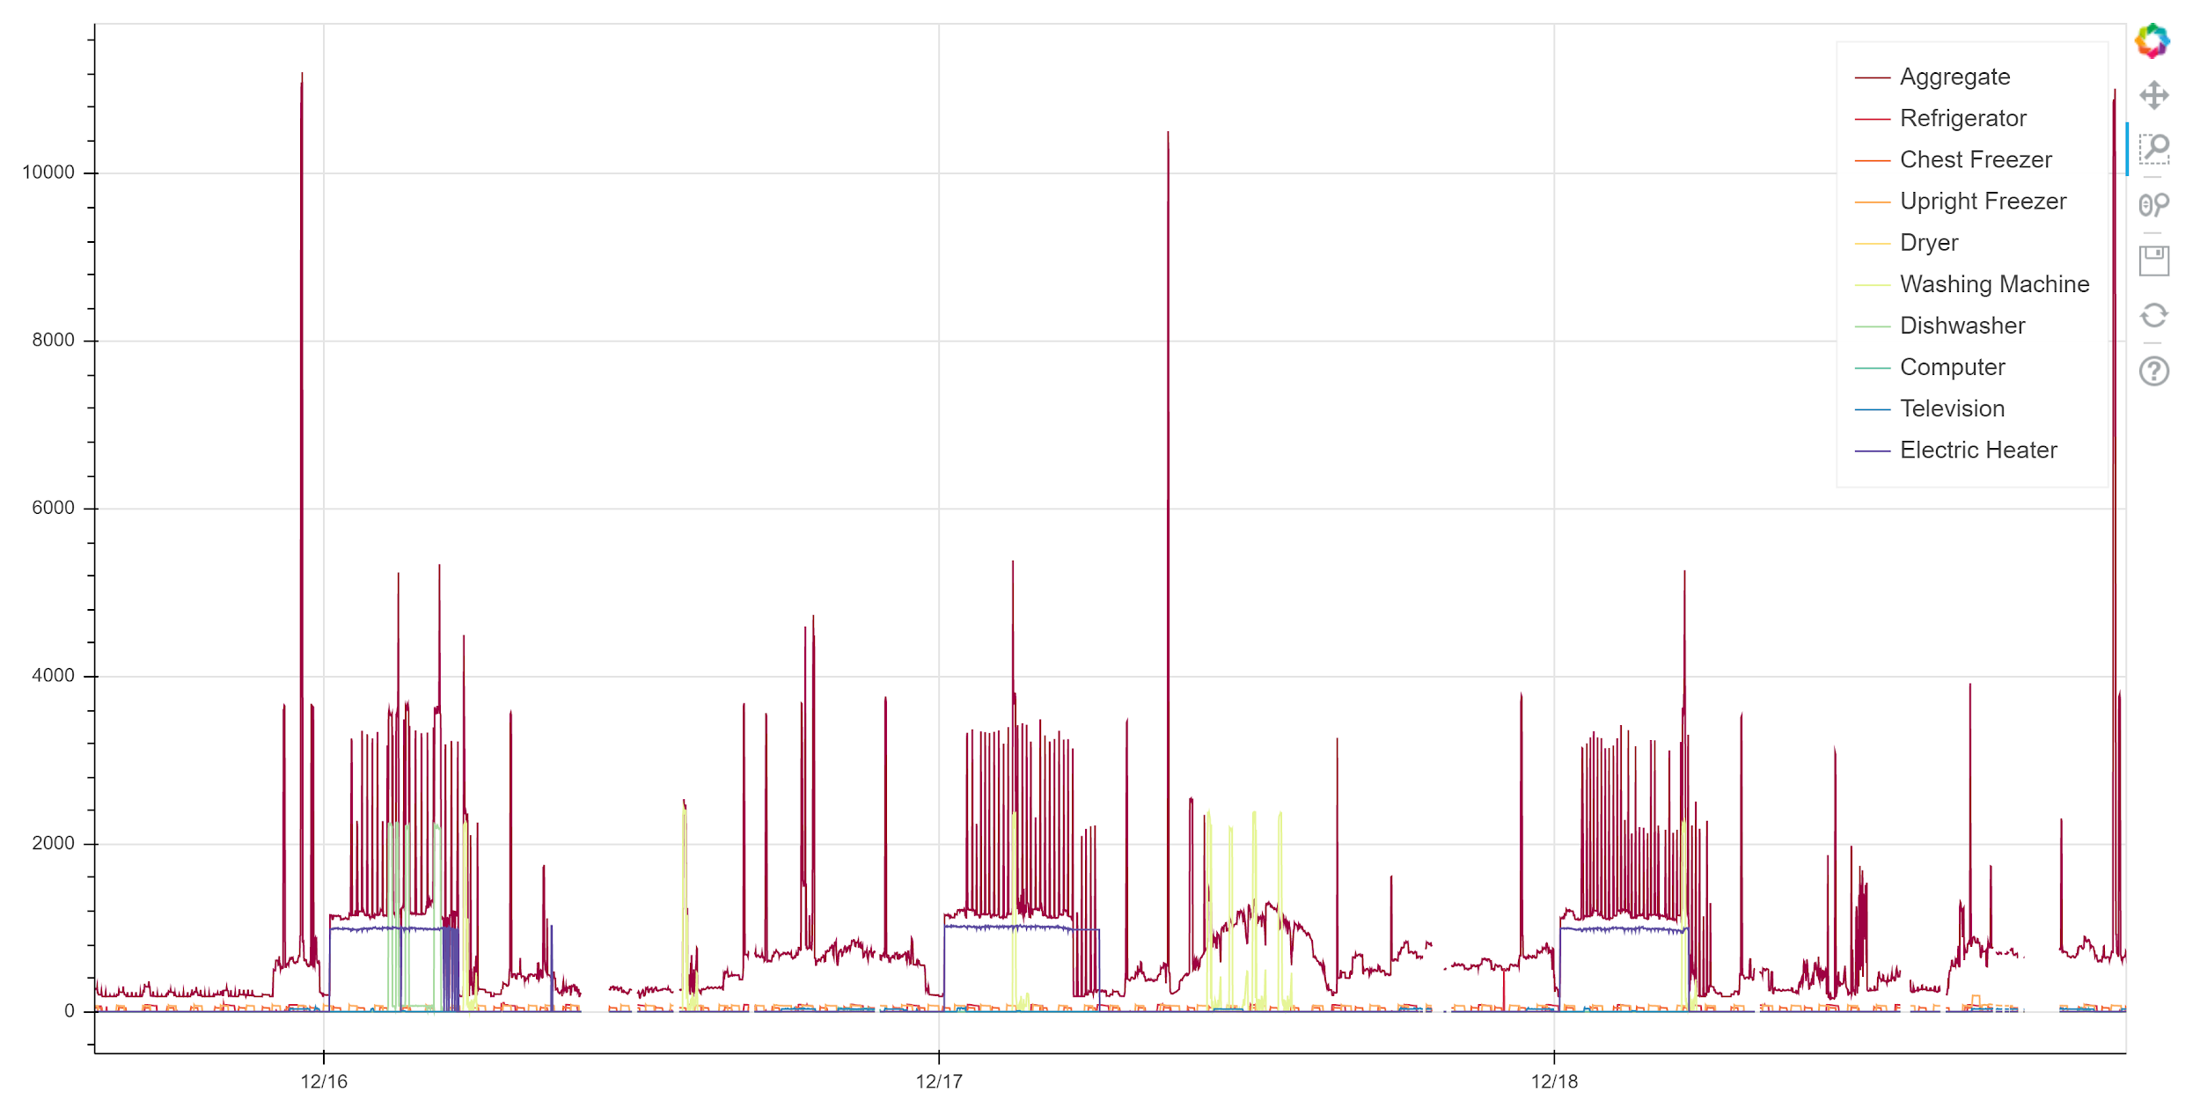
REFIT Dataset
Resampled to one minute intervals
Dropped gapped periods
Harmonics and noise
Data Gaps

Slide 11
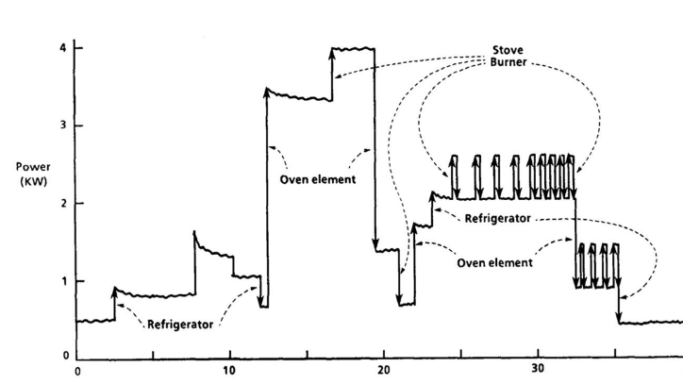
Project Goals
Disaggregate smart meter load
Detect appliance anomalies
Create itemized energy bill
Develop scalable design

Slide 12
Selected Disaggregation Models
Factorial Hidden Markov Model
Convolutional Neural Networks
Autoencoders
Notes:
Previous research has focused on four primary methods jof performing load disaggregation
We selected to explore 3 different approaches to perform disaggregation (

Slide 13
Factorial Hidden Markov Models

Slide 14
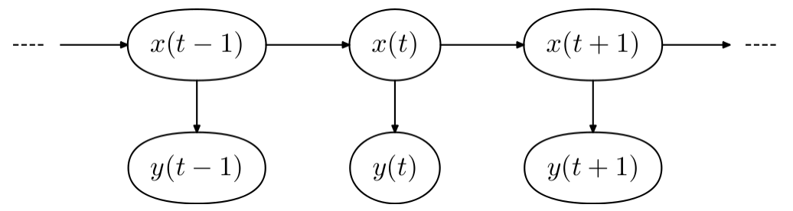
Hidden Markov Model (HMM)
Hidden Markov Model (HMM) is a type of Probabilistic Graphical Model (PGM)
Used for discrete time series applications to estimate:
Hidden States or “unobserved” (discrete)
Given Observations (continuous or discrete)
Based on the “Markov Property”/ “memoryless”
“Future State only depends on current state”
Formally: P(S_{t} | S_{t-1}) = P(S_{t} | S_{t-1}, ...,S_{t0})
Commonly used for:
Speech Recognition | Handwriting Recognition

Slide 15
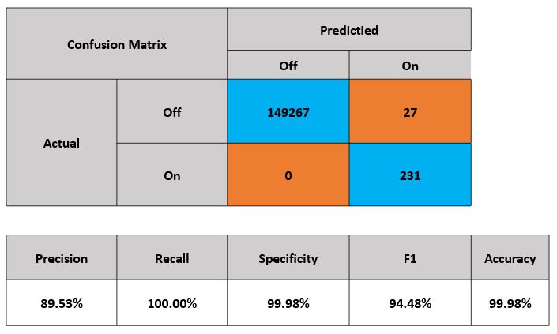
House 18 - Washer Dryer Appliance trained on Appliance load
State Transition Matrix
90%
ON
1%
10%
OFF
99%

Slide 16
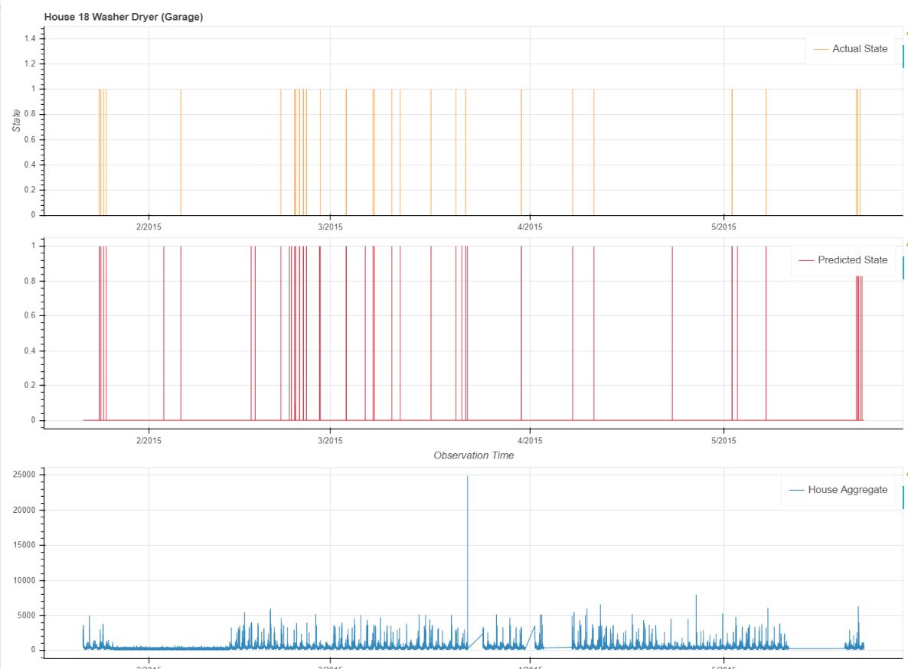
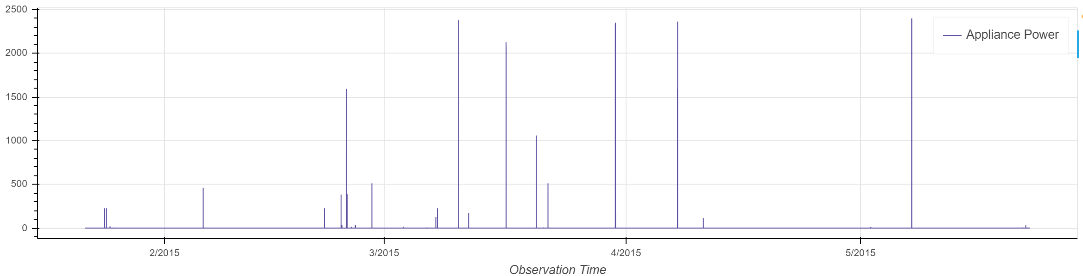
Washer Dryer Trained on Appliance load

Slide 17
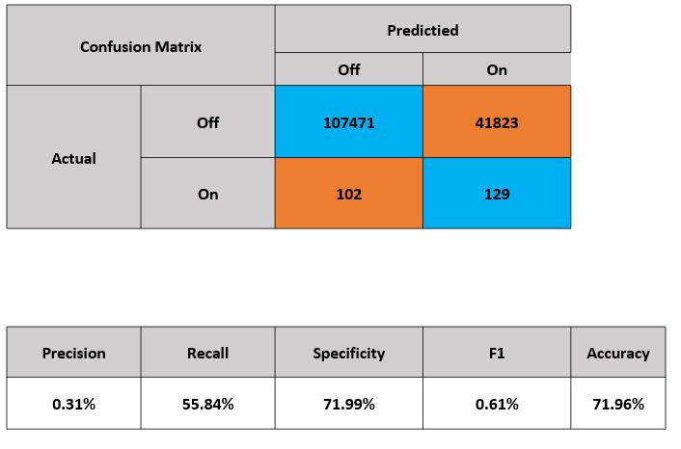
House 18 - Washer Dryer Appliance trained on Aggregate
State Transition Matrix
90%
ON
1%
10%
OFF
99%

Slide 18
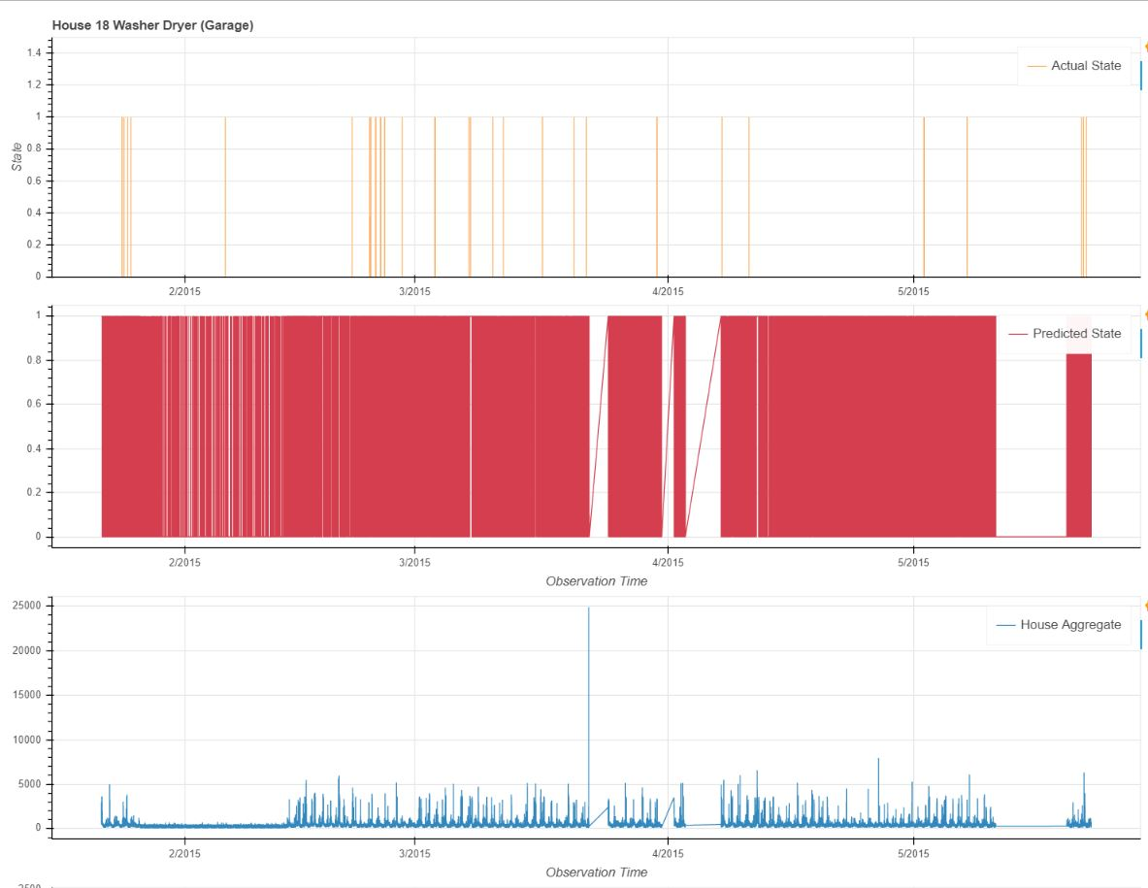
Washer
Dryer
Trained on Aggregate

Slide 19
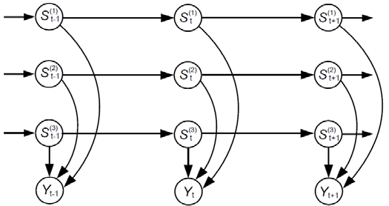
Factorial Hidden Markov Model (FHMM)
Parameters of FHMM: λ = (π, A, θ)
π = Initial Hidden State Distribution
A = State Transition Matrix
θ = Emission (Observation) Transition Matrix
Factorial Hidden Markov Model for top 3 appliances
(S_{i}) = Appliances
Hidden State = ON / OFF
(y_{t}) = House Aggregate at time (t)

Slide 20
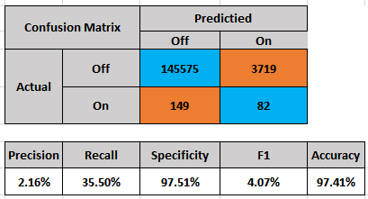
House 18 - Washer Dryer Appliance trained on Aggregate
State Transition Matrix
90%
ON
1%
10%
OFF
99%

Slide 21
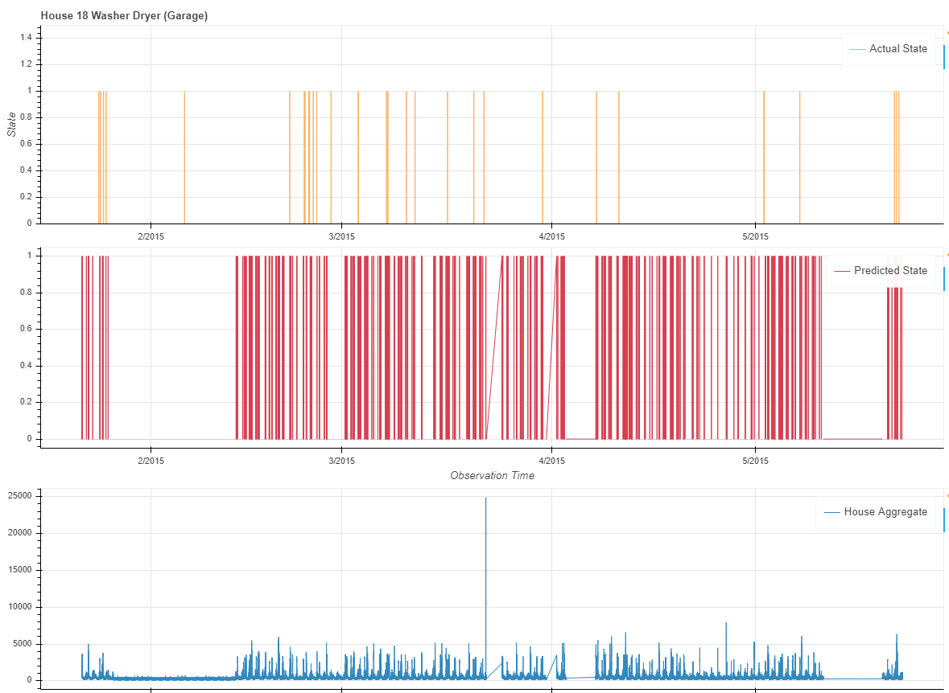
Washer
Dryer
Trained on Aggregate

Slide 22
FHMM Model Testing Results
Appliance | MAE | SAE
Dishwasher | 27.0 | 0.151
Washing Machine | 33.0 | 4.89
Fridge | 32.0 | 0.849
Microwave | 22.0 | 4.79

Slide 23
Factorial Hidden Markov Model Recap
Possible performance improvements:
Account for additional states of the appliance beyond ON and OFF
Ex/ “High-ON”, “Low-ON”
Factor in additional variables into the model such as:
Temperature
time of day
day of week
Condition on the ON/OFF duration of the appliance
A Hidden Semi-Markov Model

Slide 24
Neural Networks

Slide 25
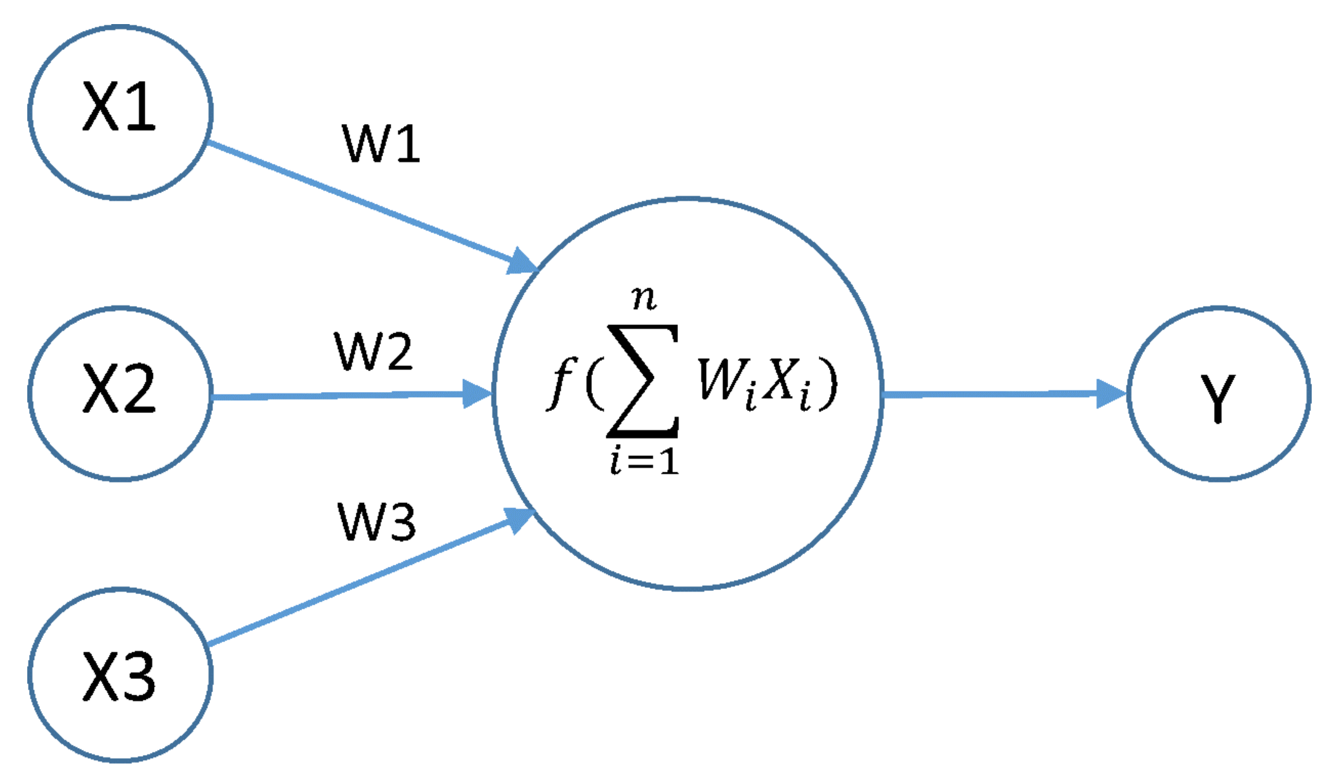
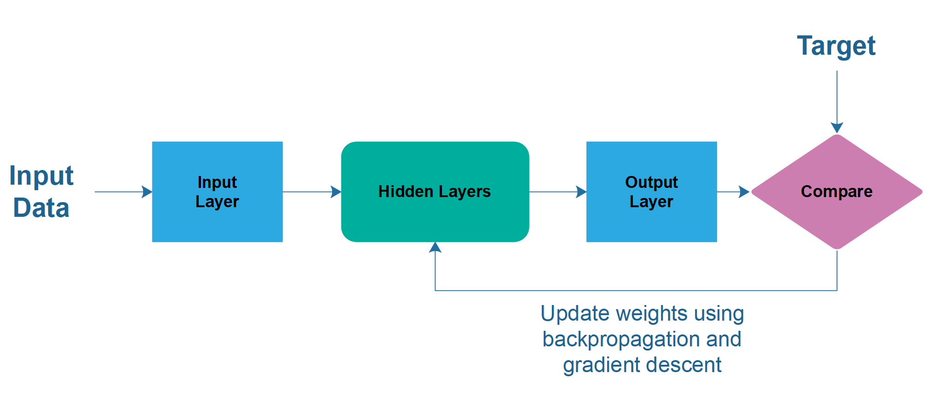
Neural Networks
Automatically detects features in the data using network of artificial neurons
Input: Aggregate smart meter data
Target: Submetered appliance data
Network detects features in the aggregate that indicate appliance activation.
1 model trained per appliance
Notes:
Artificial neuron takes a vector of inputs, for each input it has a weight (and bias) and it multiplies each input by the weight and sums them together. Passes the output of the sum to an activation function (typically nonlinear). Can take a series of artificial neurons to create a network where each neuron is wired up to neurons of the previous layer.
To start, we initialize weights randomly within some bounds. Calculate results of input by feeding forward results and compare to the target output. Update the weights using gradient descent: apply chain rule to get derivative of the activation functions and backpropagate changes in weights to minimize loss. By loss we mean some distance between the predicted output and the actual target value.
Advantages:
No need for feature engineering
Achieves accurate regression results
Do not need to specify which appliances are in a house
Disadvantages
Requires a lot of data and training time
Models are difficult to interpret

Slide 26
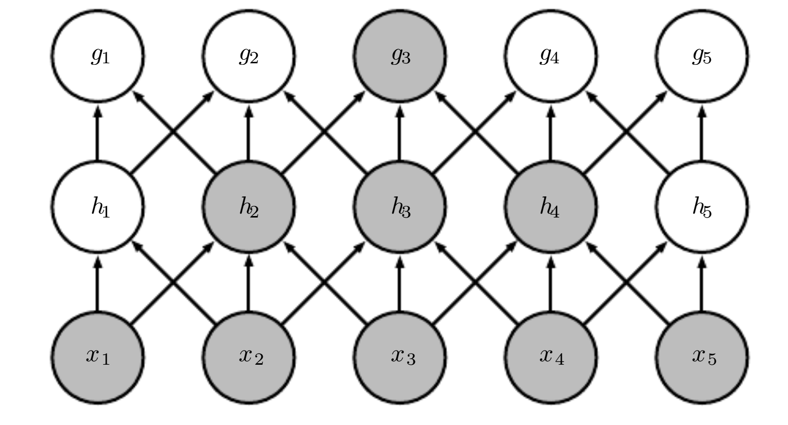
Convolutional Neural Networks
Output
Convolution: dot product of a filter with a sequence (kernel) of input data
Filters are trained to identify unique features in time-series data
Can be used with a sequence-to-sequence (autoencoder) or sequence-to-point convolutional architecture
Kernel
Input
Notes:
What is convolution? Definition and comparison to 2-D image classification

Slide 27
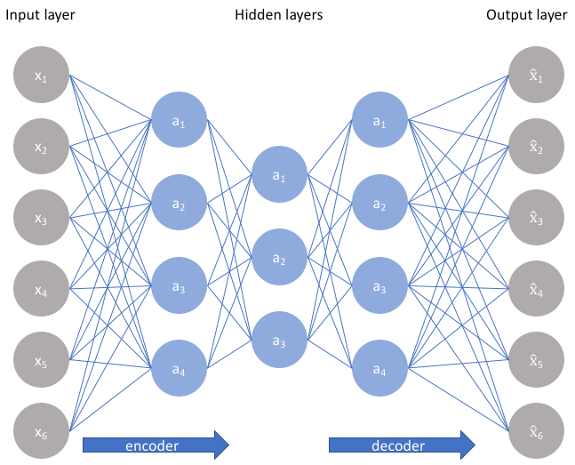
Autoencoder Networks
Unsupervised learning technique
Bottleneck architecture
Forces a compressed knowledge representation of the original input
Latent space representation
Denoising
Notes:
Autoencoder (AE):
A network that tries to reconstruct the output.
Encodes the input to a compact vector representation
Then decodes to reconstruct the input
This forces the net to learn a compact representation of the data
similar to dimensionality reduction.
Identifying dimensions with largest reconstruction error can be used to detect anomalies.
Denoising Autoencoder (dAE):
Attempts to reconstruct a clean target from a noisy input.
Aggregate data is considered “noisy” due to the power demand of other appliances.
Aggregate power demand is the input
The clean power demand of the target appliance is the output

Slide 28
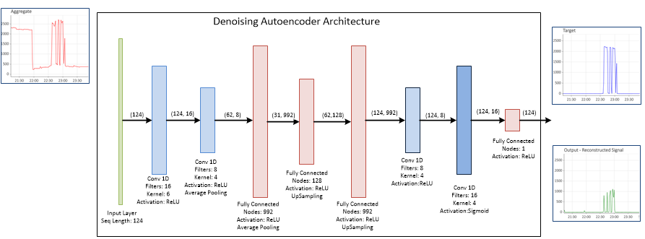


Denoising Autoencoder model architecture

Slide 29
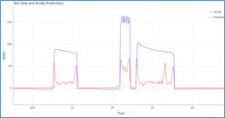
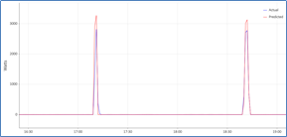
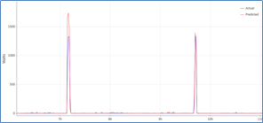
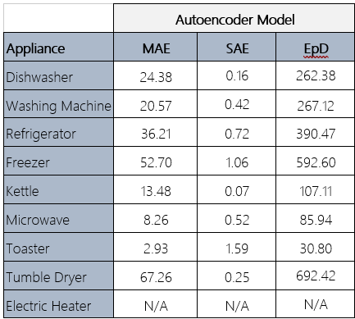
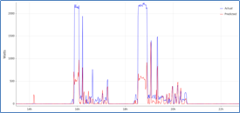
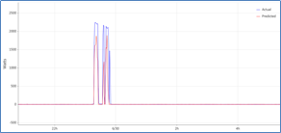
Denoising Autoencoder Results
Fridge Kettle Microwave
Washing Machine Dishwasher

Slide 30
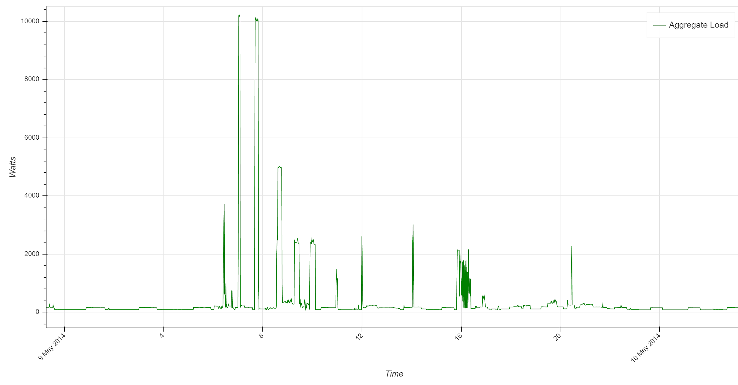
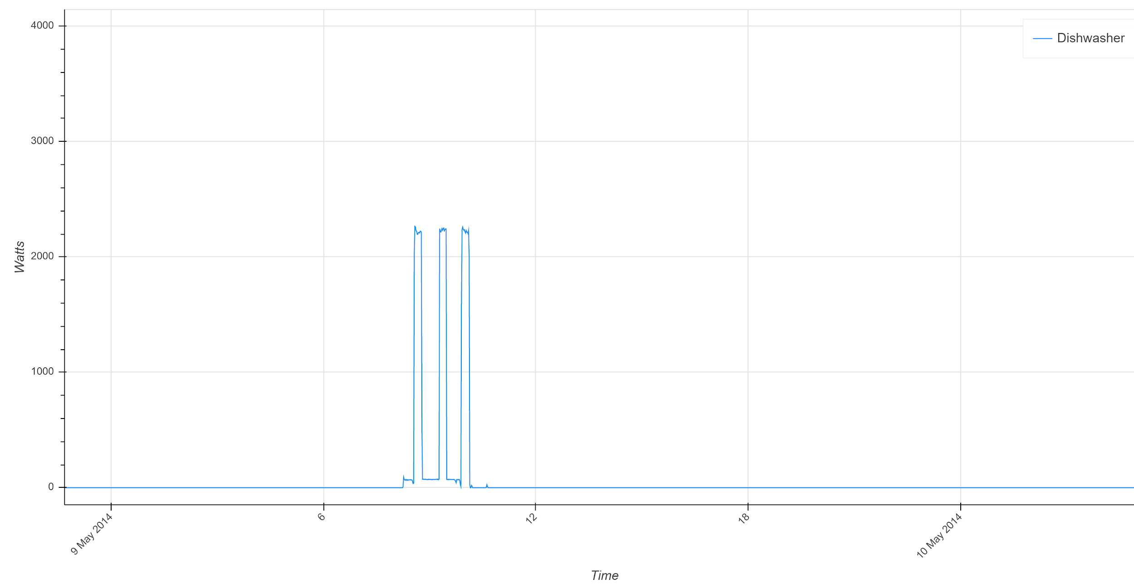
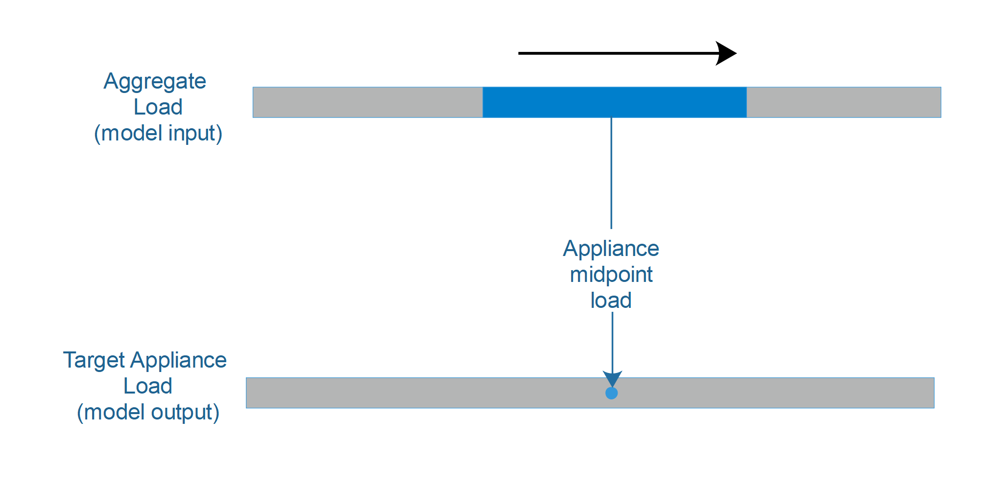
Sequence-to-point Convolutional Network
Model Input: sequences of a fixed length that move forward one timestep per sequence
Target: appliance load at the midpoint of each sequence

Slide 31
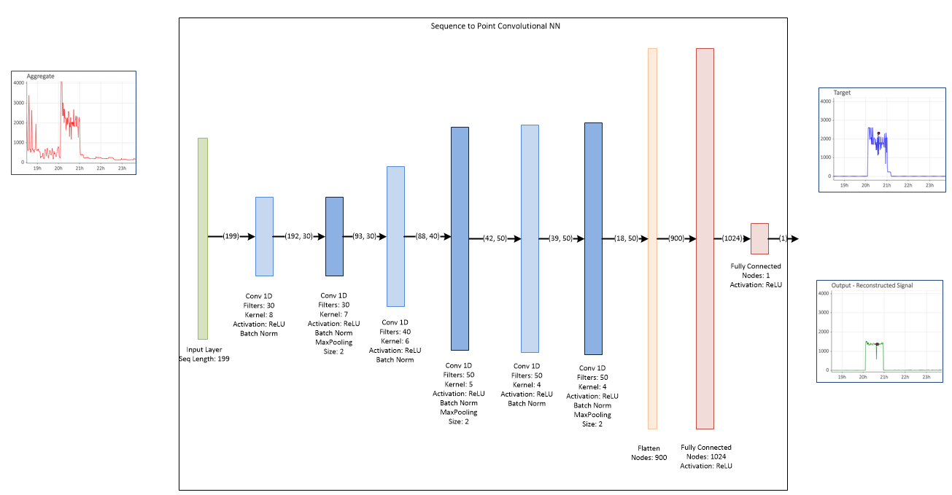
Sequence-to-point Convolutional Network
Aggregate sequence
Appliance
midpoint

Slide 32
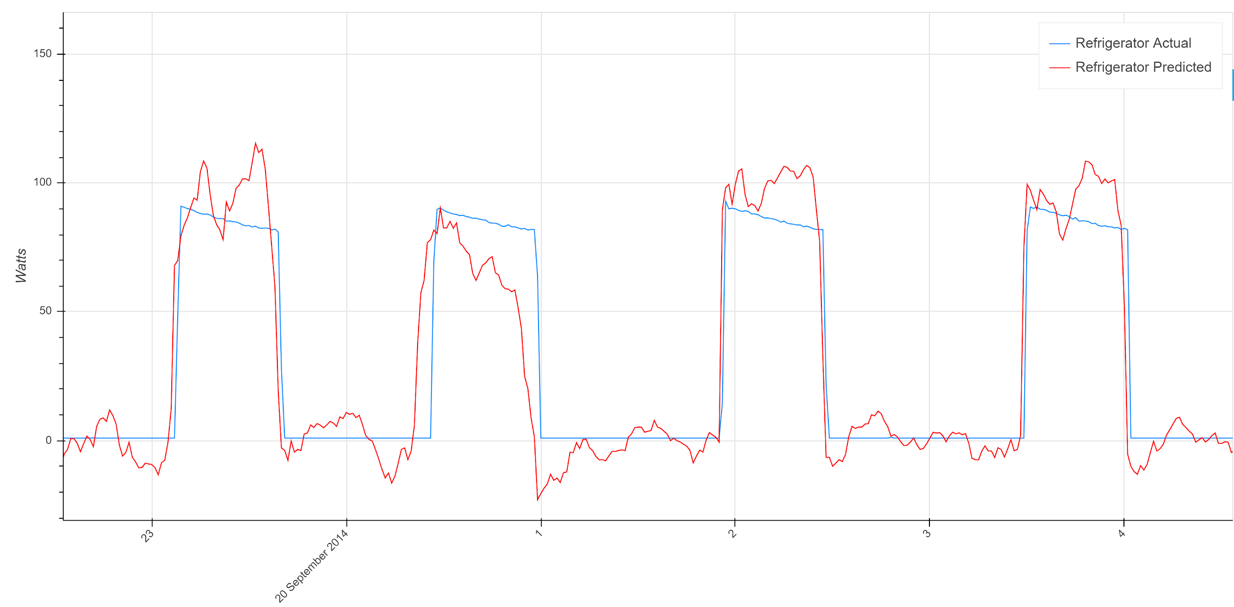
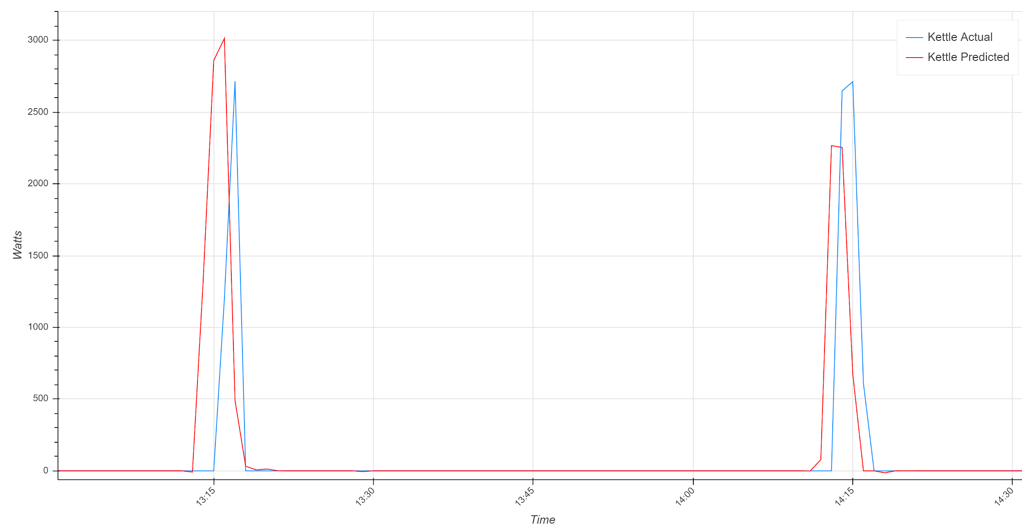
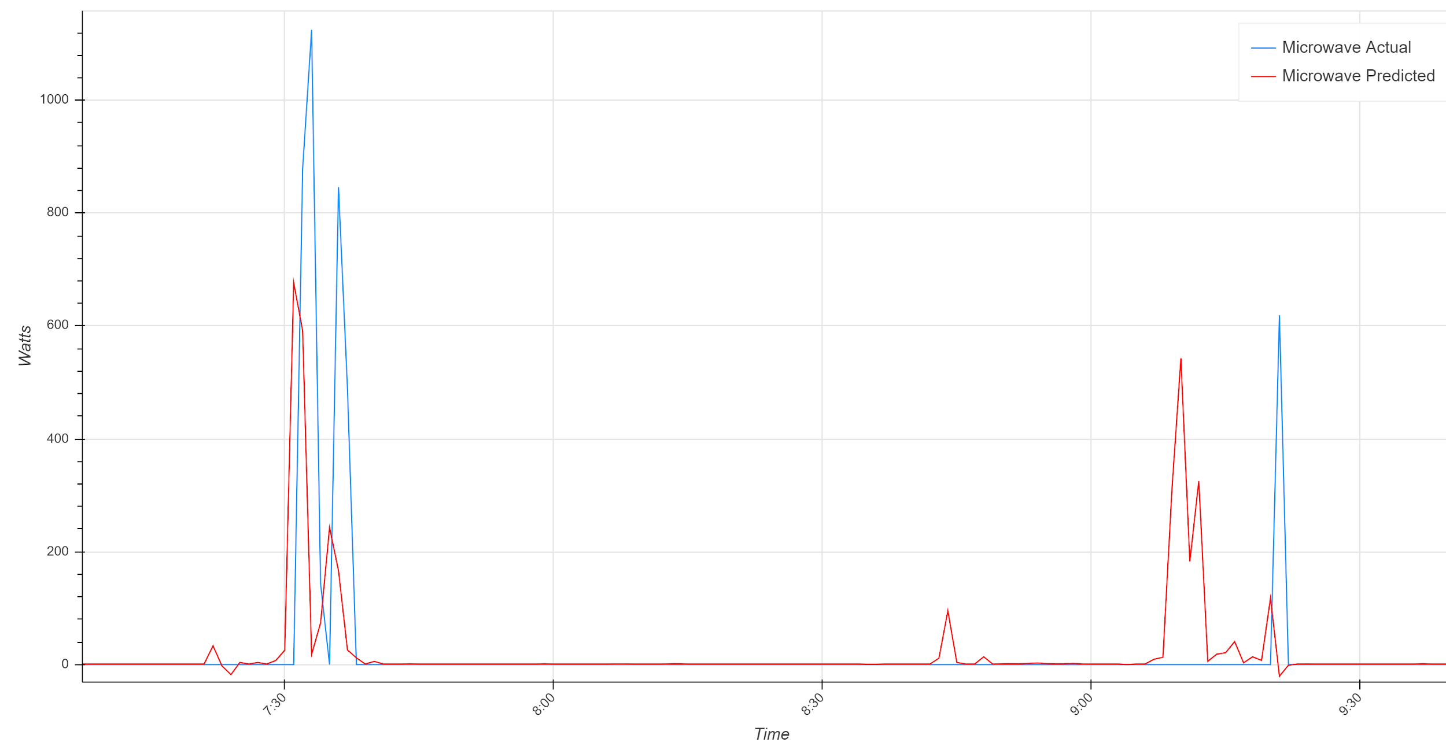
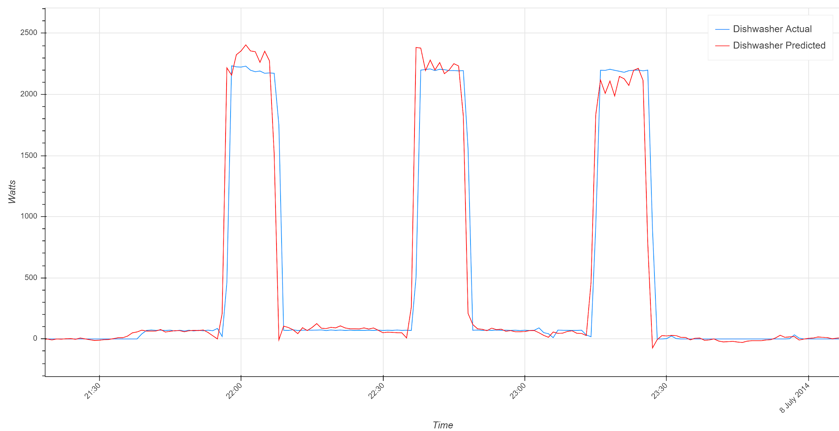
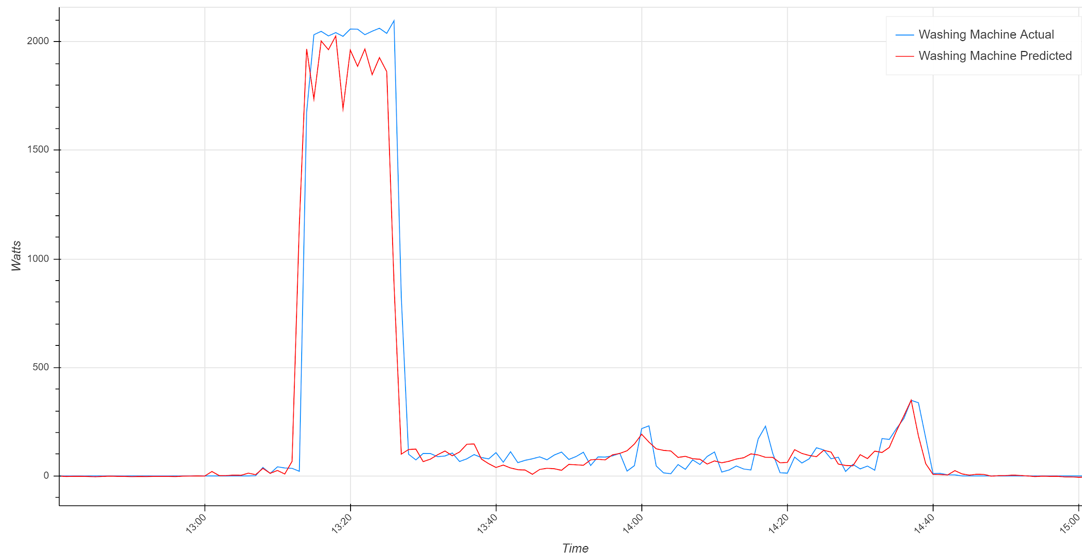
Sequence-to-point CNN Results
Refrigerator
Kettle
Microwave
Dishwasher
Washing Machine

Slide 33
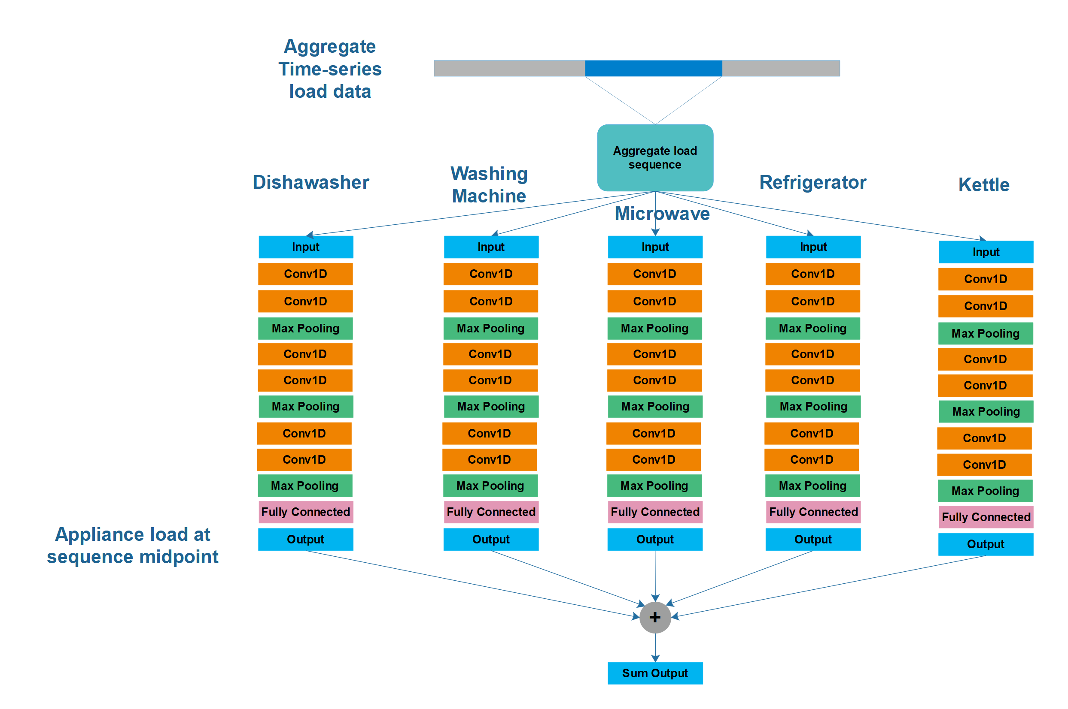
Combined Seq2Point CNN Architecture
Future Research

Slide 34
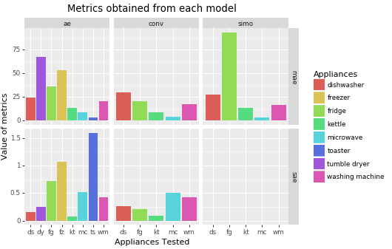
Neural Network Performance
Metrics used:
mae mean absolute error
sae signal aggregate error
Notes:
Explain the gaps in the metrics by saying that some of our more complex models required more development time as well as training and testing, which precluded us from obtaining as many metrics.
The autoencoder is less complex and faster, so we were able to obtain more metrics.
From what we can see here the Conv and SIMO models both demonstrate good performance, although more development would be required to get complete results.
Another thing to not is that the AE and CONV are individual models per appliance but hte SIMO is 5 appliances all together, which is amazing.

Slide 35
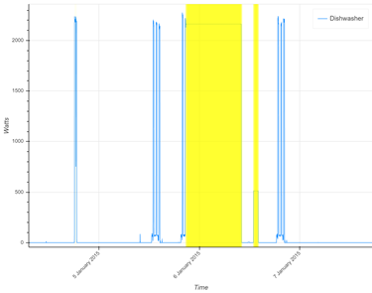
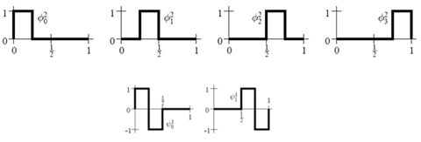
Anomaly detection
Goal: Detect anomalies in appliance operation using only aggregate data.
Approach:
Use Autoencoder to reconstruct disaggregated appliance waveform
Measure dissimilarity between
Discrete wavelet transform coefficients
Dishwasher

Slide 36
Visualizations
and
Conclusions

Slide 37
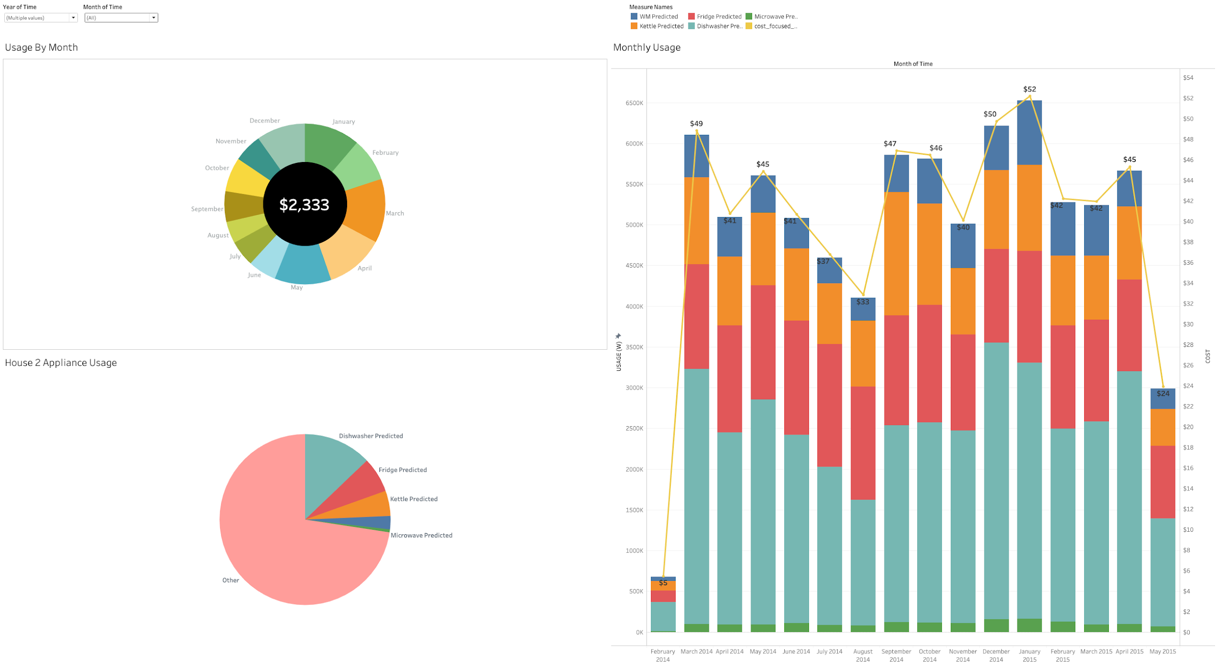
Itemized Energy Bill

Slide 38
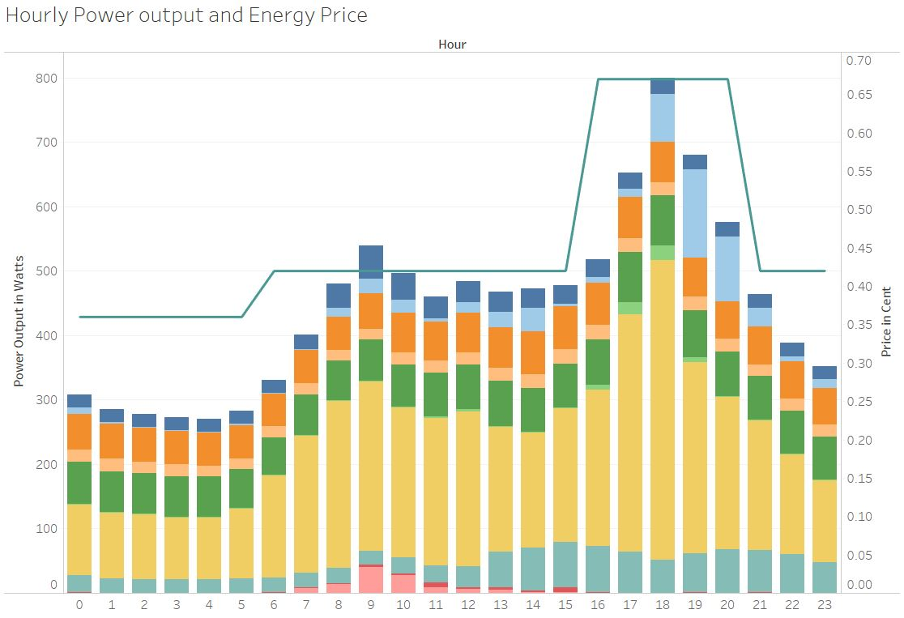


Slide 39

Concept for Disaggregation at scale
~100 houses to participate in pilot program
Install sensors on major appliances and measure at 1-minute intervals or shorter. Record data for 6-12 months
Train models on each submetered appliance using as many houses as feasible.
Create data pipeline to retrieve and monitor smart meter data from participating customers at regular intervals (monthly, weekly, etc.)
Retrain models every 3-5 years to learn changes in usage patterns and new appliances.

Slide 40
Conclusion
Developed accurate Disaggregation Models
Implemented anomaly detection
Showed how model can be useful to electric utilities and customers
Set out plan for Disaggregation at scale

Slide 41
Acknowledgements
Special thanks to the following GMU Professors for their advice on this project:
Professor Vadim Sokolov
Professor Kathryn Laskey

Slide 42
Questions?

Slide 43

Results from other researchers
D´Incecco, Squartini, Zhong 2019
Used 8 second data

Slide 44
Model Evaluation and Tuning
Tune model hyperparameters
Learning rate
Filter size
Number of conv layers
Max pooling configuration
Batch size
Sequence length
Output layer configuration/activation function

